Slide 1
Getting to Know the New
Societies Act & Societies Online
Presented by:
Aurora Beraldin
Trish Reimer
Policy and Legislative Analyst
Policy and Legislation Division
Ministry of Finance
Manager, Business Services
Service BC
Ministry Citizen’s Services

Slide 2


Slide 3
Benefits of the New Societies Act
  Re-organizes legislation
  Simplifies the rules
  Provides more flexibility
  Electronic filing system

Slide 4
HIGHLIGHTS

Slide 5
Some Highlights of the New Act
  Record-keeping
  Financial
  Meetings and governance
  Directors

Slide 6
Record-keeping
Members have the right to see their society’s records
Bylaws may restrict access to
  accounting records and
  directors’ minutes
Directors can restrict access to register of members to protect privacy, but access must be allowed for corporate purposes
Special resolutions no longer filed at Corporate Registry

Slide 7
Financial
Special resolution is no longer required for borrowing by a society
Financial statements must continue to be produced and be made available to the public
There are no rules on how financial statements must be prepared – however, remuneration of directors and highest-paid employees must be disclosed
Act does not require audited statements

Slide 8
Meetings and Governance
General meetings may be conducted electronically or by consent resolution
An AGM need only be held once every calendar year
Proxy voting okay if permitted by bylaw
Special resolution default is 2/3, but bylaws can set higher threshold
Unalterable provisions can be altered after a society “transitions”

Slide 9
Directors – Future Requirements
Applicable in November 2018:
Directors and senior managers must meet basic qualifications
Directors must consent to their appointment
Directors’ remuneration is allowed only if permitted by the bylaws
Majority of the board must be unaffiliated (not employed by the society)

Slide 10
A Date to Remember
November 28, 2018
New director requirements apply
&
Existing societies must have “transitioned” to the new Act

Slide 11
TRANSITION

Slide 12
Transition
What is it?
Filing an electronic version of your constitution and bylaws
In some cases making changes to your constitution and bylaws
Deciding whether to be “member-funded”

Slide 13
What is a Member-funded Society?
A society that is funded primarily by its members to carry on activities for the benefit of its members
  No significant public funding
  Inward-looking activities
Slightly less “regulation” applies:
  No public access to financial statements
  No disclosure of directors/employee remuneration
  Only one director is required and no “unaffiliated” board requirements
  Can freely distribute assets on winding up

Slide 14
Important Decision!
  Member-funded status will affect:
  public profile
  registered charity status
  future funding (e.g. no gaming grants)

Slide 15
Member-funded: To Be or Not to Be?
Your society cannot be a member-funded society if it:
  is a type of society prohibited from being one (registered charity, student society, independent school, hospital, public housing provider)
  receives more than a certain amount (roughly $10,000/year) in public donations or government funding
  is unable to get approval by a special resolution of its members

Slide 16
Member-funded? Decide before Transitioning
On transition, you will be prompted about whether your society wishes to be a member-funded society
After transition, an ordinary society can become a member-funded society ONLY if it obtains a court order
If your society is uncertain, may wish to delay transitioning until legal advice can be obtained

Slide 17
Basic Transition
  Enter your society’s purposes into its new constitution
  Move any other provisions from the old constitution into the bylaws
  Upload a consolidated set of the existing bylaws, including provisions moved under step 2, flagging any that were “previously unalterable”
  Do not opt to become a member-funded society

Slide 18
Example
Before
Constitution
The purpose is to end poverty.
There will be 6 directors.
Directors may not be paid. This provision is unalterable.
Bylaws
The members shall consist of…
A member may be expelled if…
After
Constitution
The purpose is to end poverty.
Bylaws
The members shall consist of…
A member may be expelled if…
There will be 6 directors.
Directors may not be paid. This provision was previously unalterable.

Slide 19
Transition Process
Basic: society does only what is required (as shown in the example) and does not want to be a member-funded society
  No directors’ resolution, members’ meeting or special resolution required
Not-so-basic: society wants to be a member-funded society or wants to make bylaw changes other than those required
  Member approval by special resolution required

Slide 20
Bylaw Changes to Consider
    Providing for unusual terms of office
    Allowing for proxy voting
    Restricting borrowing by society
    Changing the threshold for special resolutions generally or the threshold needed to change certain bylaws
No changes to unalterable provisions are allowed on transition

Slide 21
LEGISLATION UPDATE

Slide 22
Common Questions:
Access to records
Disclosure of remuneration
Notice of meetings
Member-funded societies

Slide 23
Amending Bill
Timing TBD
Amendments to
    fix technical glitches
    clarify intent

Slide 24
REGISTRIES
Engagement
Accessing Societies Online
Screenshots

Slide 25
Registries Society Engagement
General Communication:
  Multiple letters/emails were sent to societies
  Regular website updates
Survey: BC Registries consulted with societies through a BC Stats survey in November 2015
Development: BC Registries conducted User Experience Design
Presentations: In-person presentations were held for over 1,100 societies across BC and counting

Slide 26
Benefits of Electronic Filing
Majority of filings will be self serve and immediate:
  no backlog
  no waiting
  no need for priority fees
Electronic access to all documents for improved access and usability
No search fees to access records filed by own society

Slide 27
Accessing Societies Online
Societies were sent a letter in November 2016 with a Registry key
If you have not received this onboarding letter please contact Registries

Slide 28
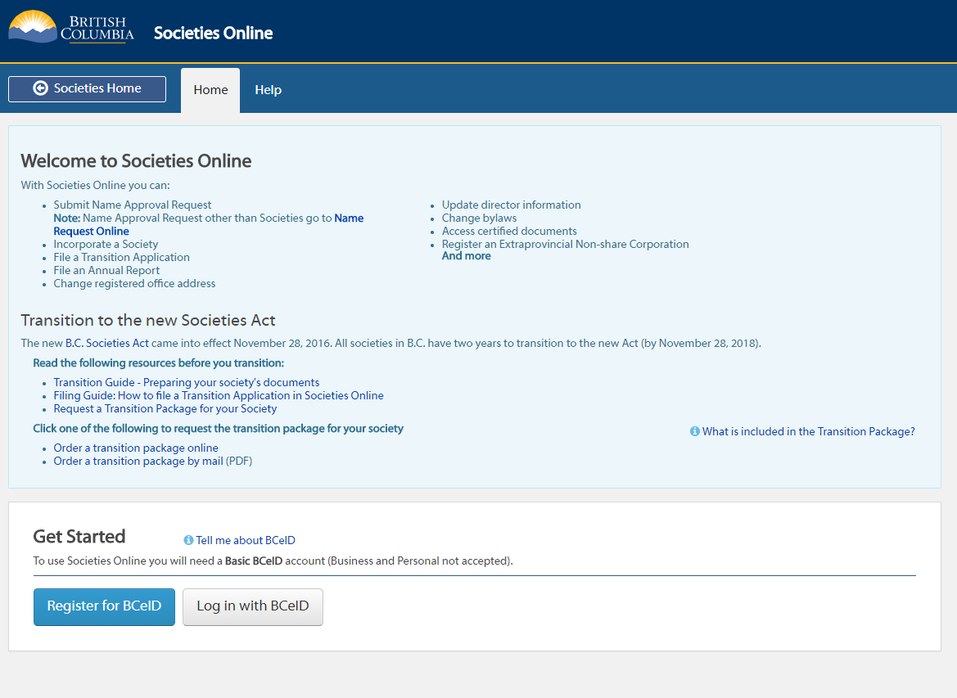
Log-in Screen

Slide 29
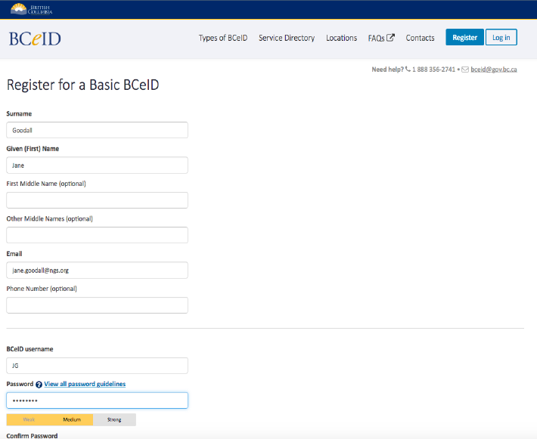

Slide 30
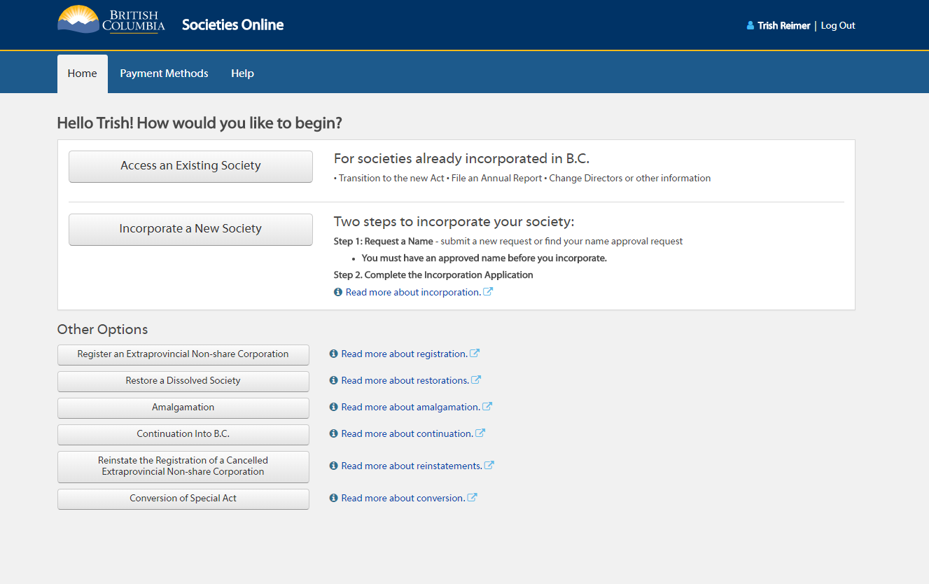

Slide 31
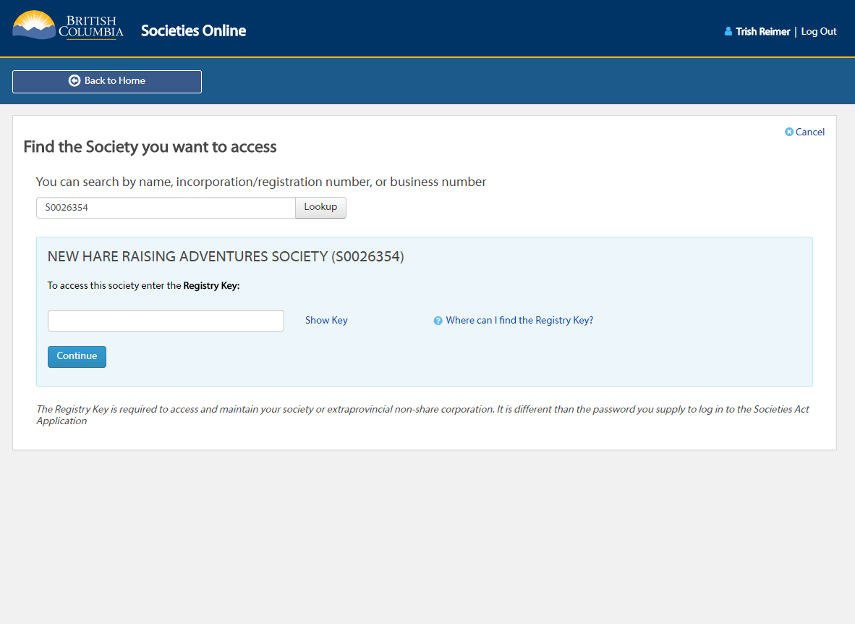

Slide 32
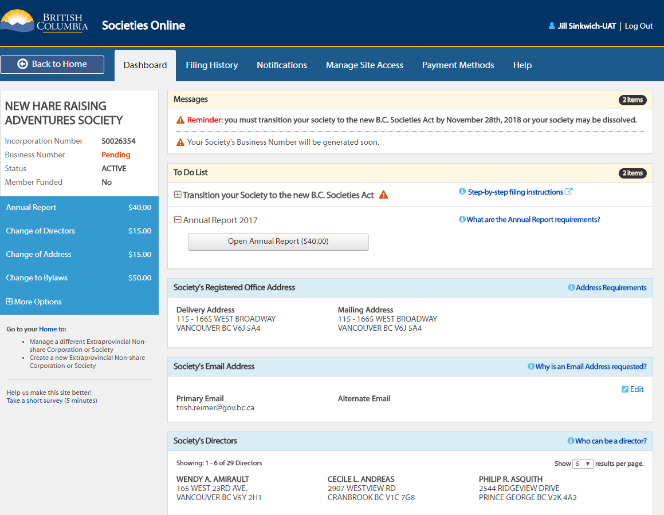
Society’s Dashboard

Slide 33
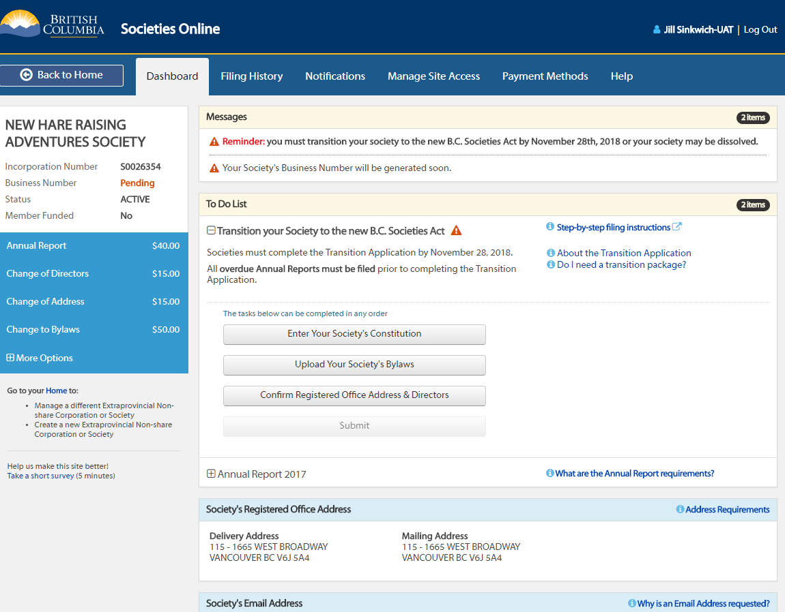

Slide 34
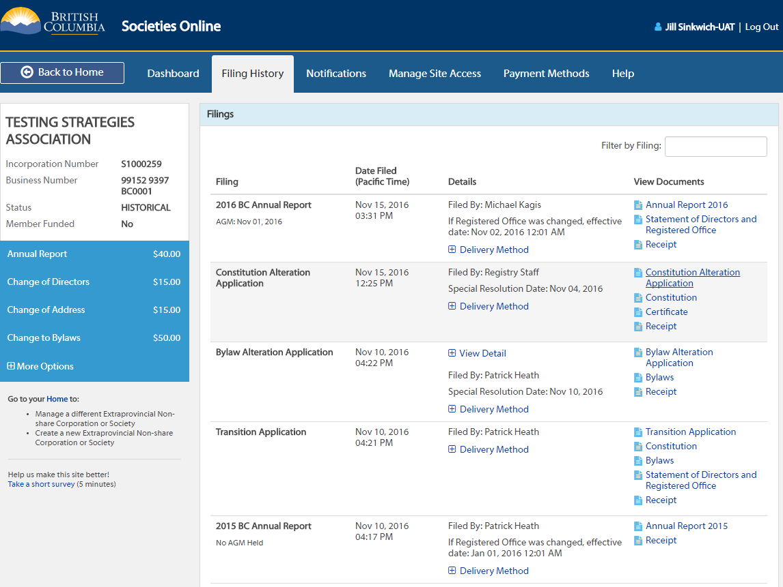
Filing History

Slide 35
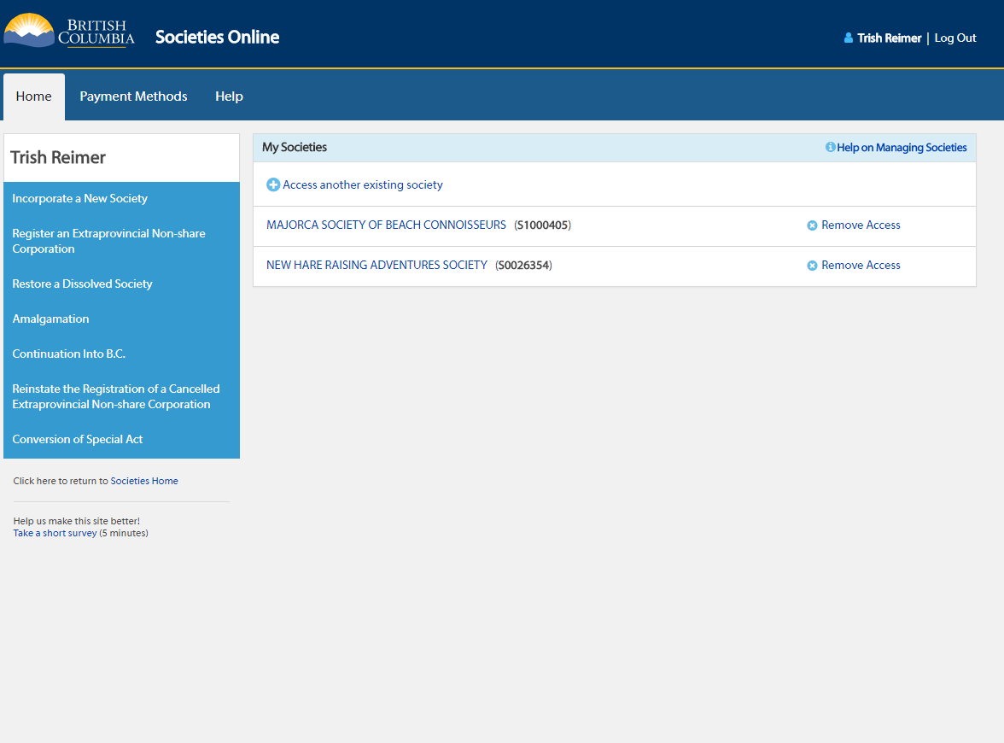

Slide 36
Security
BCeID – login for each user
      Registry key – password for society

Slide 37
Societies Online Usage
As of November 21, 2017, there has been significant take up in societies accessing the new system:
    6,419 Transition Filings
    22,709 Annual Report Filings
    1872 Incorporations
    12,028 Other Filings

Slide 38
www.gov.bc.ca/SocietiesOnline

Slide 39

Questions
Aurora Beraldin
Policy and Legislative Analyst
Email: Aurora.Beraldin@gov.bc.ca
Phone: 1-778-698-5266
Trish Reimer
Manager, Business Services
Email: trish.reimer@gov.bc.ca
Phone: 1-250-356-9405
Notes:
Please contact us if you any questions.

